Slide 1
106-2 (EE5022) 電腦輔助積體電路系統設計 Computer-aided VLSI System Design Final Project
楊家驤 教授
TA: 李懷霆/王勝輝/王于哲
2018.05.15

Slide 2
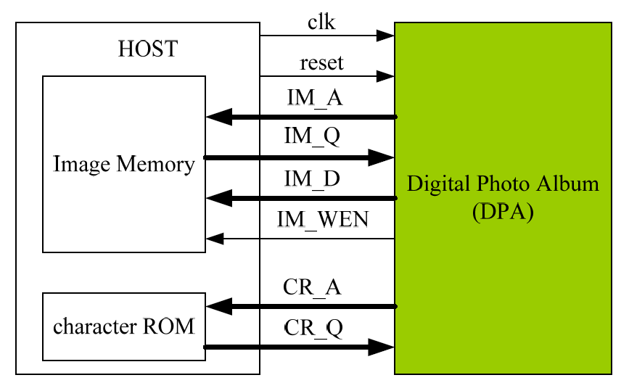

Final Project
Focus on a simple but complete VLSI design and flow!
Topic: Digital Photo Album
More details in the document
2 students form a team
Team up deadline: 2018/05/22 (email to TA: r05943016@ntu.edu.tw)
Otherwise, TA will help to form teams for students who are alone.

Slide 3
Grading Rules
等級A+ : 完成等級A，並且其
Area (um²) * Toggle Count < Baseline
等級A : 達成”完成設計”之三項要求
功能正確，RTL模擬與正確解答比對完全正確。
完成Synthesis，且Gate-Level Pre-layout Simulation結果正確。
完成APR，並達成APR必要項目，Gate-Level Post-layout Simulation結果正確。
等級A- : 已做到APR，但等級A之”APR必要項目”有部分不符合，DRC/LVS錯誤總數量容許5個(含)以下。
等級B : 僅完成合成，或做到APR，但DRC/LVS錯誤總數量超過5個以上。
等級C : 僅完成RTL simulation。
等級D : 以上標準皆未達成。
Baseline design and some bonus rules will be announced later.
The top 12 teams will present on 2018/07/03. All students attend.

Slide 4
完成APR之必要項目
VDD與VSS Power Ring寬度請各設定為2um，只需做一組
不需加Dummy metal
Power Stripe務必至少加一組，其VDD、VSS寬度各設定為2um
(Power Stripe垂直方向至少一組、水平方向可不加)
務必要加Power Rail (follow pin)
Core Filler務必要加
APR後之GDSII檔案務必產生
完成APR，DRC/LVS完全無誤

Slide 5
繳交檔案
RTL Category
Design Stage | File | Description
N/A | GroupID.pdf | Design Report
RTL Simulation | DPA.v | Verilog synthesizable RTL code
Gate-Level Category
Design Stage | File | Description
Pre-layout Gate-level Simulation | DPA_syn.v | Verilog gate-level netlist generated by Synopsys Design Compiler
 | DPA_syn.sdf | Pre-layout gate-level sdf
 | DPA_syn.ddc | Design database generated by Synopsys Design Compiler
Physical Category
Design Stage | File | Description
P&R | DPA.gds | GDSII layout
 | DRC/LVS report | 截圖放入GroupID.pdf中，需在Design Report 中填寫DRC/LVS錯誤總數量。(目標要做到0個錯誤!)
Post-layout Gate-level Simulation | DPA_pr.v | Verilog gate-level netlist generated by Cadence Encounter
 | DPA_pr.sdf | Post-layout gate-level sdf

Slide 6
Design Report
(1) Layout Area
(2) DRC錯誤總數量
(3) LVS錯誤總數量
(4) Toggle Count
Also please explain what techniques are applied in your design (figure is ok, too)
請先將所有檔案放入命名為組別(例如:group01)的資料夾，再將此資料夾壓縮成一個檔案(例如:group01.zip)並上傳至指定FTP。

Slide 7
Important Dates
05/22 (Tue) before 22:00 Team up
06/19 (Tue) Announce Baseline design
06/30 (Sat) before 18:00 Final Project Submission Deadline
07/03 (Tue) 14:20-17:20 Project Presentation

